Slide 1

Collision avoidance simulator in autonomous driving PROJECT SOFTWARE-DEFINED COMMUNICATION SYSTEMS
Umberto Pirovano - Andrea Conese - Andrea Paternò - Hamze Ghorbani Koujani
15/04/24

Slide 2
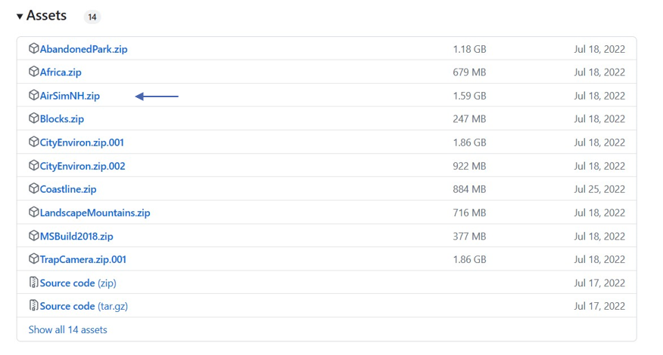
Points of what we have done :
setup airsim

Slide 3
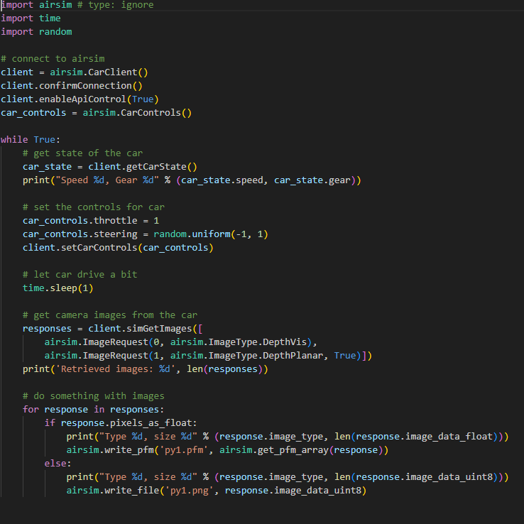
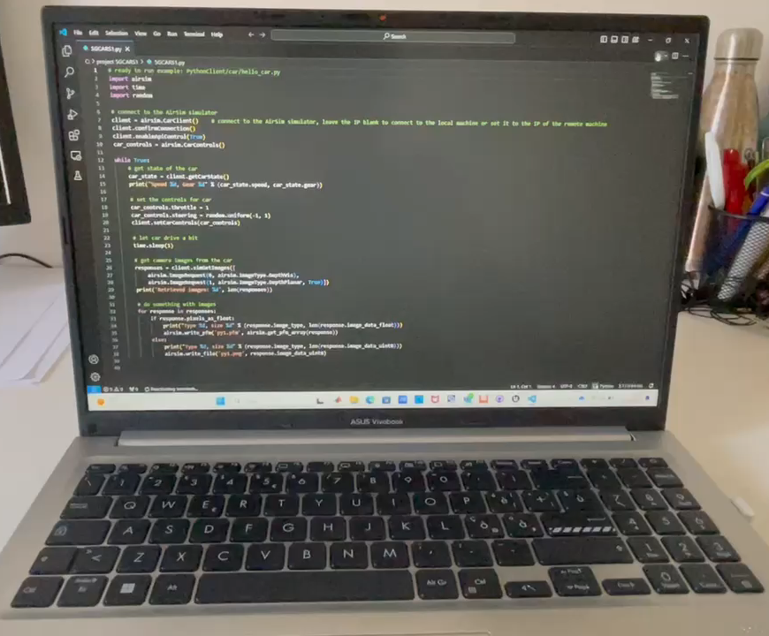
Python script to move the car and get images from the camera

